Slide 1
Network
Notes:
Cisco Networking Academy Program
Introduction to Networks v6.0
Chapter 1: Explore the Network

Slide 2


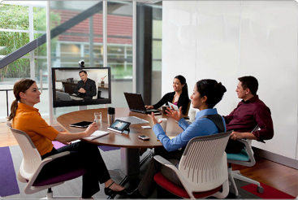
Globally Connected Networking Today
Network has no boundary and supports the way we:
Learn
Communicate
Work
Play
Notes:
1.1 – Globally Connected
1.1.1 – Network Today

Slide 3
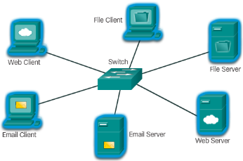
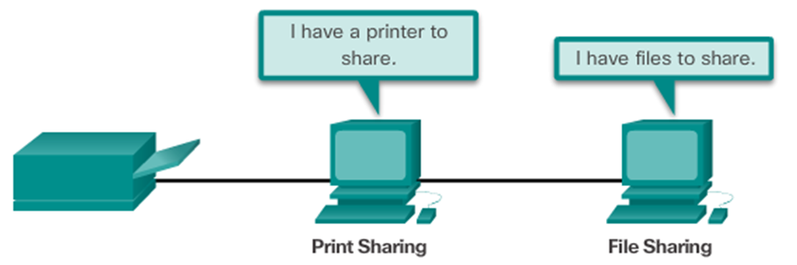
Globally Connected Providing Resources in a Network
Networks of Many Sizes
Small Home / Office Networks
Medium to Large Networks
World Wide Network
Clients and Servers
Clients request and display information
Servers provide information to other devices on the network
Peer-to-Peer
Computers can be both server and client at the same time.
What are the advantages?
What are the disadvantages?
Notes:
1.1 – Globally Connected
1.1.2 – Providing Resources in a Network

Slide 4
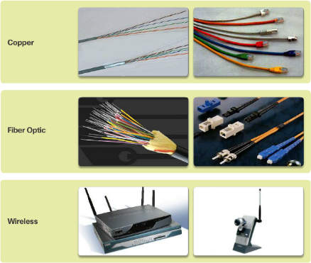
LANs, WANs, and the Internet Network Components
End Devices
Either the source or destination of a message
Name some end devices
Intermediary Network Devices
Connect multiple individual networks to form an internetwork
Connect the individual end devices to the network
Ensure data flows across the network
Provide connectivity
Network Media
Provide the pathway for data transmission
Interconnect devices
Name the three types of media
Notes:
1.2 – LANs, WANs, and the Internet
1.2.1 – Network Components

Slide 5






LANs, WANs, and the Internet Network Components
Network Representations
What do the symbols represent?
Topology Diagrams
Physical
Logical
Notes:
1.2 – LANs, WANs, and the Internet
1.2.1 – Network Components

Slide 6
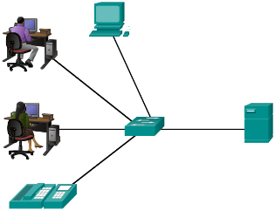
LANs, WANs, and the Internet LANs and WANs
Local Area Networks
Spans across small geographical area
Interconnects end devices
Administrated by a single organization
Provide high speed bandwidth to internal devices
WAN Area Networks
Interconnects LAN
Administrated by multiple service providers
Provide slower speed links between LANS
Can you name more network types?
Notes:
1.2 – LANs, WANs, and the Internet
1.2.2 – LANs and WANs

Slide 7
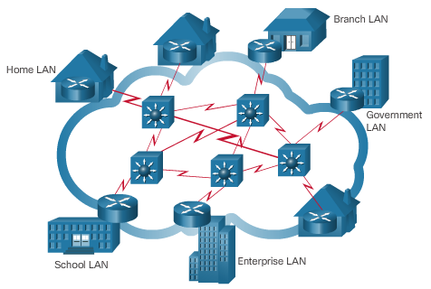
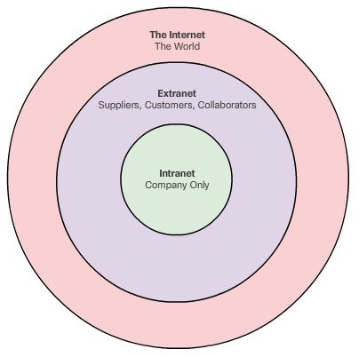
LANs, WANs, and the Internet The Internet, Intranets, and Extranets
The Internet
Worldwide collection of interconnected networks
Not owned by any individual or group
Intranets and Extranets
Notes:
1.2 – LANs, WANs, and the Internet
1.2.3 – The Internet, Intranets, and Extranets

Slide 8
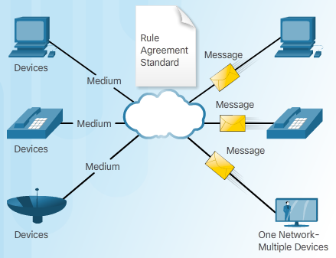
The Network as a Platform Converged Networks
Traditional Separate Networks
Each network with its own rules and
The Converging Network
Capable of delivering data, voice, and video over the same network infrastructure
Notes:
1.3 – The Network as a Platform
1.3.1 – Converged Networks

Slide 9
3.1 Rules of Communication
Notes:
Cisco Networking Academy program
Introduction to Networks
Chapter 3: Network Protocols and Communications

Slide 10
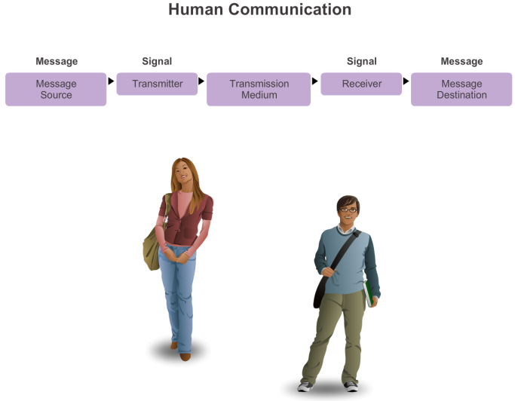
The Rules What is Communication?
Notes:
3.1.1.1 What is Communication?

Slide 11
The Rules Establishing the Rules
An identified sender and receiver
Agreed upon method of communicating (face-to-face, telephone, letter, photograph)
Common language and grammar
Speed and timing of delivery
Confirmation or acknowledgment requirements
Notes:
3.1.1.2 Establishing the Rules

Slide 12
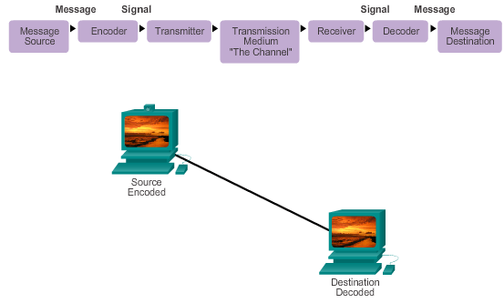
The Rules Message Encoding
Notes:
3.1.1.3 Message Encoding

Slide 13

The Rules Message Formatting and Encapsulation
Example: Personal letter contains the following elements:
Identifier of the recipient’s location
Identifier of the sender’s location
Salutation or greeting
Recipient identifier
The message content
Source identifier
End of message indicator
Notes:
3.1.1.4 Message Formatting and Encapsulation

Slide 14
The Rules Message Size
An overview of the segmenting process:
The size restrictions of frames require the source host to break a long message into individual pieces (or segments) that meet both the minimum and maximum size requirements.
Each segment is encapsulated in a separate frame with the address information, and is sent over the network.
At the receiving host, the messages are de-encapsulated and put back together to be processed and interpreted.
Notes:
3.1.1.5 Message Size

Slide 15
The Rules Message Timing
Access Method
Flow Control
Response Timeout
Notes:
3.1.1.6 Message Timing

Slide 16
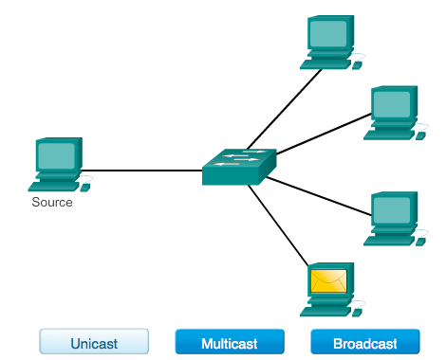
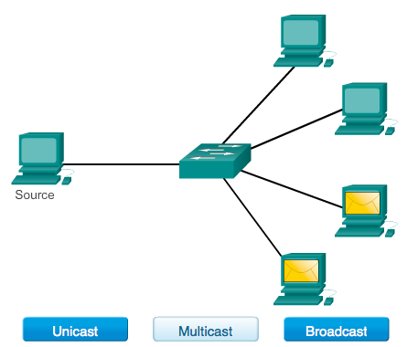
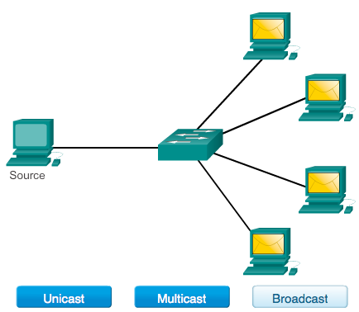
The Rules Message Delivery Options
Notes:
3.1.1.7 Message Delivery Options

Slide 17
Network Protocols and Standards
Notes:
Cisco Networking Academy program
Introduction to Networks
Chapter 3: Network Protocols and Communications

Slide 18
Protocols Network Protocols
How the message is formatted or structured
The process by which networking devices share information about pathways with other networks
How and when error and system messages are passed between devices
The setup and termination of data transfer sessions
Notes:
3.2.1.2 Network Protocols

Slide 19
Protocols Interaction of Protocols
Application Protocol – Hypertext Transfer Protocol (HTTP)
Transport Protocol – Transmission Control Protocol (TCP)
Internet Protocol – Internet Protocol (IP)
Network Access Protocols – Data link & physical layers
Notes:
3.2.1.3 Interaction of Protocols

Slide 20
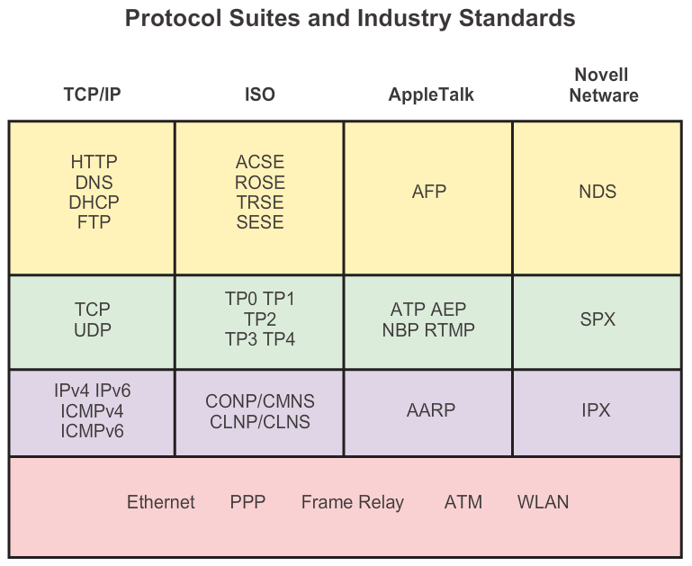
Protocol Suites Protocol Suites and Industry Standards
Notes:
3.2.2.1 Protocol Suites and Industry Standards

Slide 21
Protocol Suites Creation of Internet, Development of TCP/IP
The first packet switching network and predecessor to today’s Internet was the Advanced Research Projects Agency Network (ARPANET), which came to life in 1969 by connecting mainframe computers at four locations.
ARPANET was funded by the U.S. Department of Defense for use by universities and research laboratories. Bolt, Beranek and Newman (BBN) was the contractor that did much of the initial development of the ARPANET, including creating the first router known as an Interface Message Processor (IMP).
In 1973, Robert Kahn and Vinton Cerf began work on TCP to develop the next generation of the ARPANET. TCP was designed to replace ARPANET’s current Network Control Program (NCP).
In 1978, TCP was divided into two protocols: TCP and IP. Later, other protocols were added to the TCP/IP suite of protocols including Telnet, FTP, DNS, and many others.
Notes:
3.2.2.2 Creation of the Internet and Development of TCP/IP

Slide 22
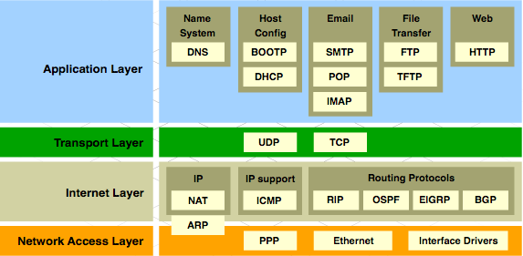
Protocol Suites TCP/IP Protocol Suite and Communication
Notes:
3.2.2.3 TCP/IP Protocol Suite and Communication Process

Slide 23
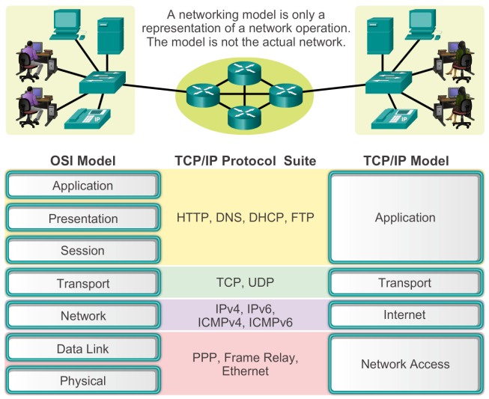
Reference Models Benefits of Using a Layered Model
Notes:
3.2.4.1 The Benefits of Using a Layered Model

Slide 24
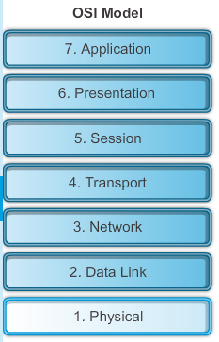
Reference Models The OSI Reference Model
Notes:
3.2.4.2 The OSI Reference Model

Slide 25
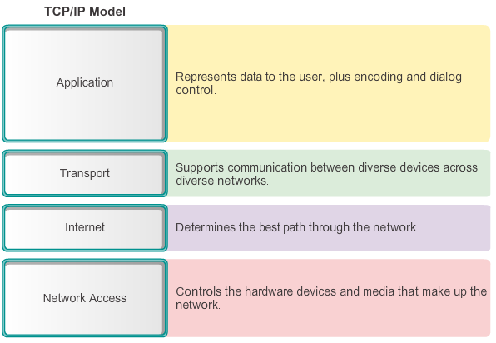
Reference Models The TCP/IP Reference Model
Notes:
3.2.4.3 The TCP/IP Protocol Model

Slide 26
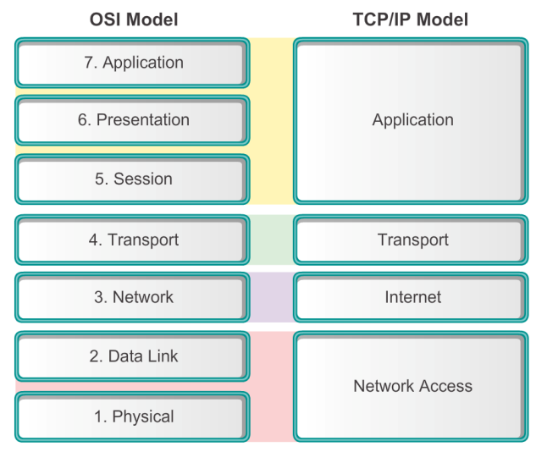
Reference Models Comparing the OSI and TCP/IP Models
Notes:
3.2.4.4 Comparing the OSI Model with the TCP/IP Model

Slide 27
3.3 Moving Data in the Network
Notes:
Cisco Networking Academy program
Introduction to Networks
Chapter 3: Network Protocols and Communications

Slide 28
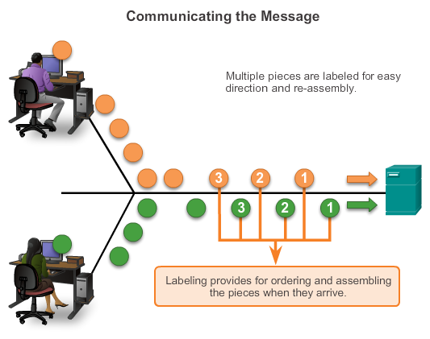
Data Encapsulation Communicating the Messages
Segmenting message benefits
Different conversations can be interleaved
Increased reliability of network communications
Segmenting message disadvantage
Increased level of complexity
Notes:
3.3.1.1 Communicating the Messages

Slide 29
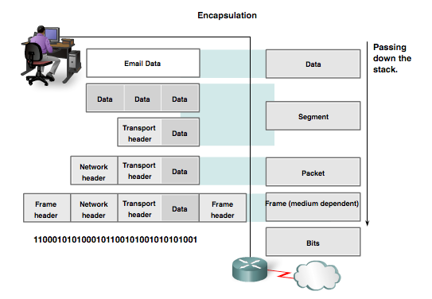
Data Encapsulation Protocol Data Units (PDUs)
Data
Segment
Packet
Frame
Bits
Notes:
3.3.1.2 Protocol Data Units (PDUs)

Slide 30
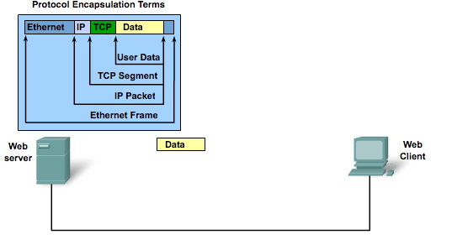
Data Encapsulation Protocol Encapsulation
Notes:
3.3.1.3 Encapsulation

Slide 31
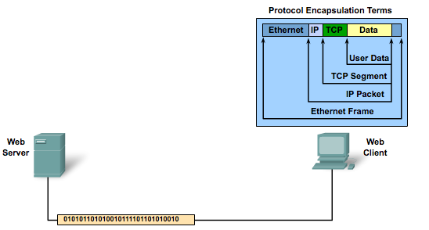
Data Encapsulation Protocol De-encapsulation
Notes:
3.3.1.4 De-encapsulation

Slide 32
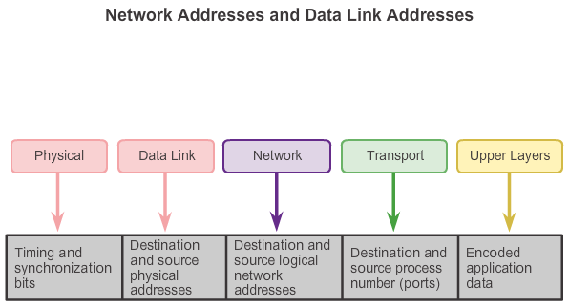
Moving Data in the Network Accessing Local Resources
Notes:
3.3.2.1 Network Addresses and Data Link addresses

Slide 33
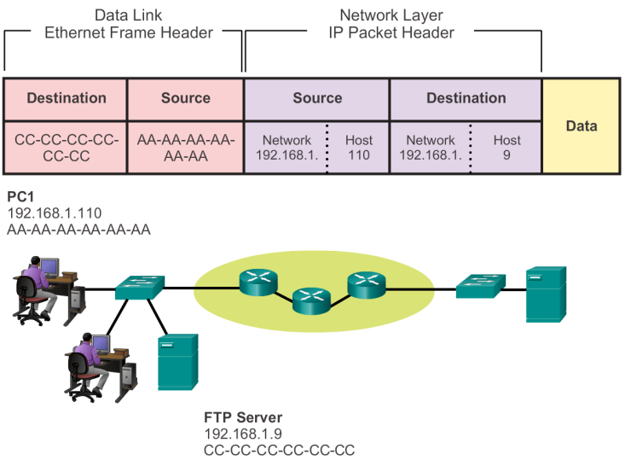

Accessing Local Resources Communicating with Device / Same Network
Notes:
3.3.2.2 Communicating with a Device on the Same Network

Slide 34


Accessing Local Resources MAC and IP Addresses
R1
192.168.1.1
11-11-11-11-11-11
ARP
Request
PC1
192.168.1.110
AA-AA-AA-AA-AA-AA
S1
R1
PC2
192.168.1.111
BB-BB-BB-BB-BB-BB
FTP Server
192.168.1.9
CC-CC-CC-CC-CC-CC
Notes:
3.3.2.3 MAC and IP Addresses

Slide 35
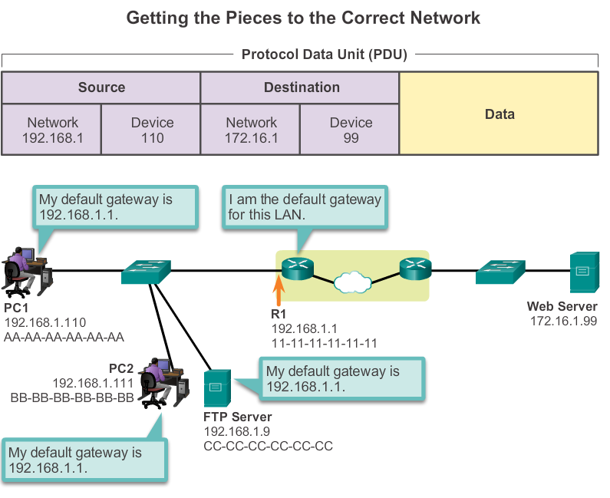
Accessing Remote Resources Default Gateway
Notes:
3.3.3.1 Default Gateway

Slide 36
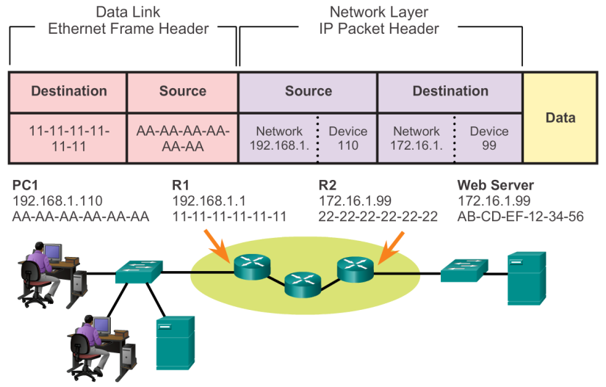
Accessing Remote Resources Communicating Device / Remote Network
Notes:
3.3.3.2 Communicating with a Device on a Remote Network

Slide 37
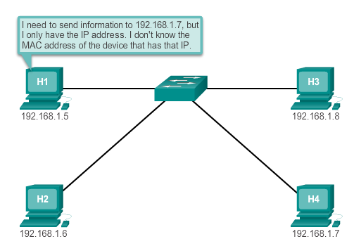
Introduction to ARP
Notes:
5.2.1.1 Introduction to ARP

Slide 38
ARP ARP Functions/Operation
ARP Table
Used to find the data link layer address that is mapped to the destination IPv4 address.
As a node receives frames from the media, it records the source IP and MAC address as a mapping in the ARP table.
ARP Request
Layer 2 broadcast to all devices on the Ethernet LAN.
The node that matches the IP address in the broadcast will reply.
If no device responds to the ARP request, the packet is dropped because a frame cannot be created.
Note: Static map entries can be entered in an ARP table, but this is rarely done.
Notes:
5.2.1.2/5.2.1.3 ARP Functions/ARP Operation

Slide 39
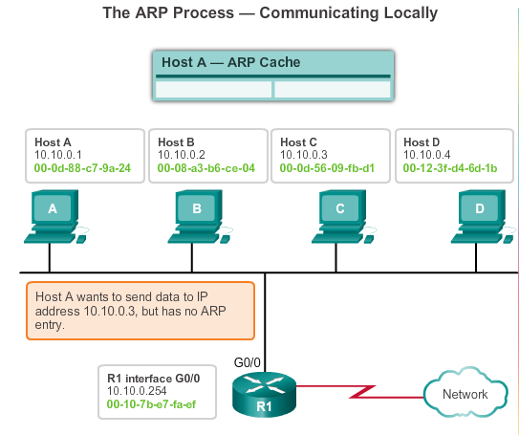
ARP ARP Operation
Notes:
5.2.1.3 ARP Operation

Slide 40
Physical Layer Overview
Notes:
Cisco Networking Academy program
Introduction to Networks
Chapter 4: Network Access

Slide 41
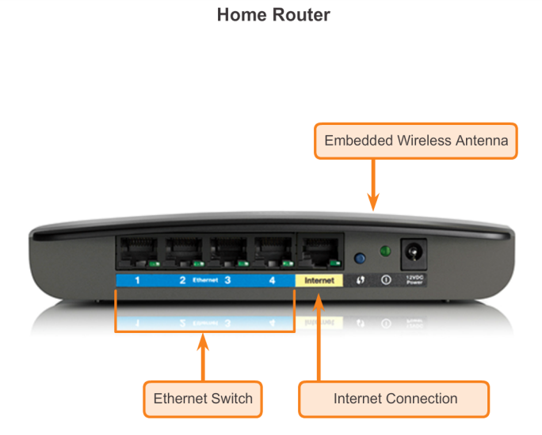
Getting it Connected Connecting to the Network
Notes:
4.1.1.1 Connecting to the Network

Slide 42
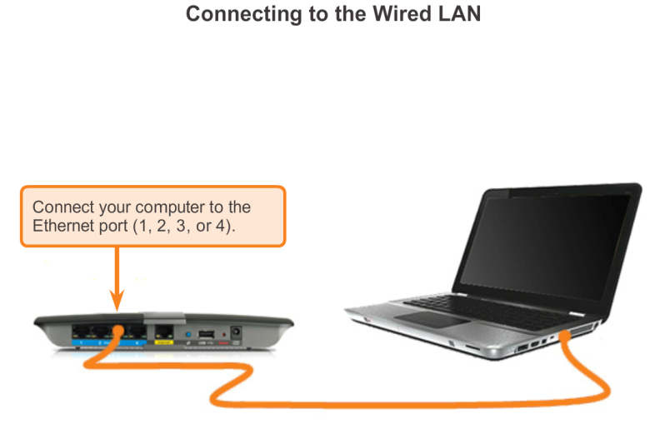
Getting it Connected Connecting to the Network (cont.)
Notes:
4.1.1.1 Connecting to the Network (cont.)

Slide 43
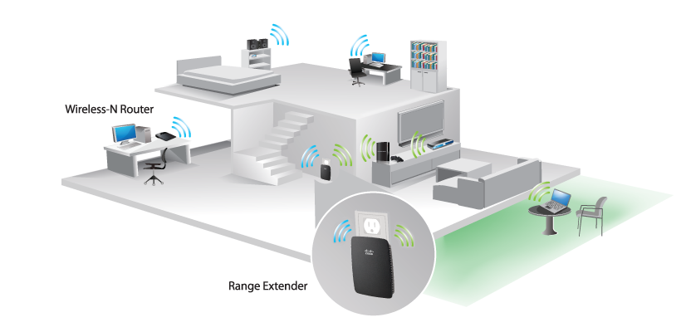
Getting it Connected Network Interface Cards
Connecting to the Wireless LAN with a Range Extender
Notes:
4.1.1.2 Network Interface Cards

Slide 44
Fundamental Principles of Layer 1 Physical Layer Fundamental Principles
Media | Physical Components | Frame Encoding Technique | Signalling Method
Copper Cable | UTP Coaxial Connectors NICs Ports Interfaces | Manchester Encoding Non-Return to Zero (NRZ) techniques 4B/5B codes are used with Multi-Level Transition Level 3 (MLT-3) signaling 8B/10B PAM5 | Changes in the electromagnetic field Intensity of the electromagnetic field Phase of the electromagnetic wave
Fiber Optic Cable | Single-mode Fiber Multimode Fiber Connectors NICs Interfaces Lasers and LEDs Photoreceptors | Pulses of light Wavelength multiplexing using different colors | A pulse equals 1. No pulse is 0.
Wireless Media | Access Points NICs Radio Antennae | DSSS (direct-sequence spread-spectrum) OFDM (orthogonal frequency division multiplexing) | Radio waves
Notes:
4.1.3.1 Physical Layer Fundamental Principles

Slide 45
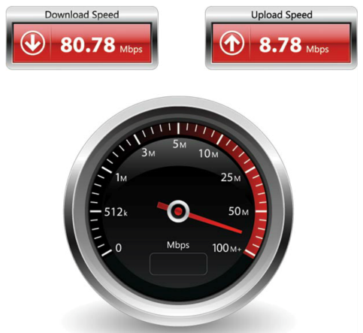
Fundamental Principles of Layer 1 Throughput
Notes:
4.1.3.3 Throughput

Slide 46
Network Media
Notes:
Cisco Networking Academy program
Introduction to Networks
Chapter 4: Network Access

Slide 47
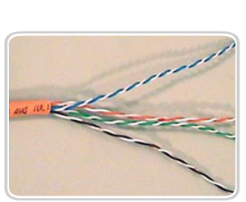
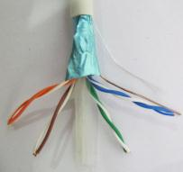

Copper Cabling Copper Media
Unshielded Twisted Pair (UTP) Cable
Shielded Twisted Pair (STP) Cable
Coaxial Cable
Notes:
4.2.1.2 Copper Media

Slide 48
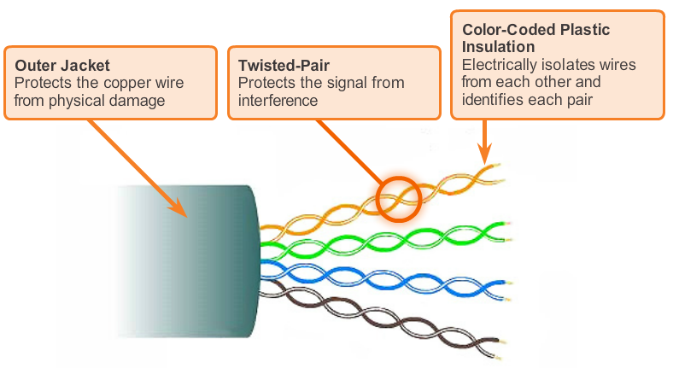
Copper Cabling UTP Cable
Notes:
4.2.1.3 Unshielded Twisted-Pair Cable

Slide 49
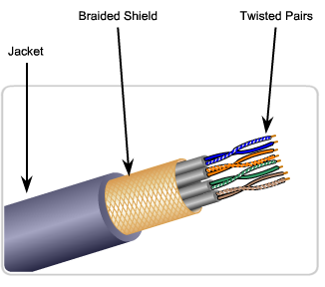
Copper Cabling STP Cable
Braided or Foil Shield
Foil Shields
Notes:
4.2.1.4 Shielded Twisted-Pair (STP) Cable

Slide 50
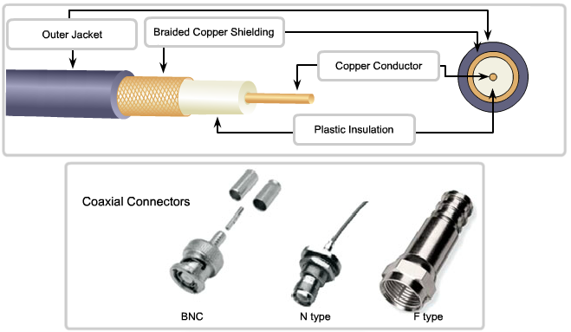
Copper Cabling Coaxial Cable
Notes:
4.2.1.5 Coaxial Cable

Slide 51
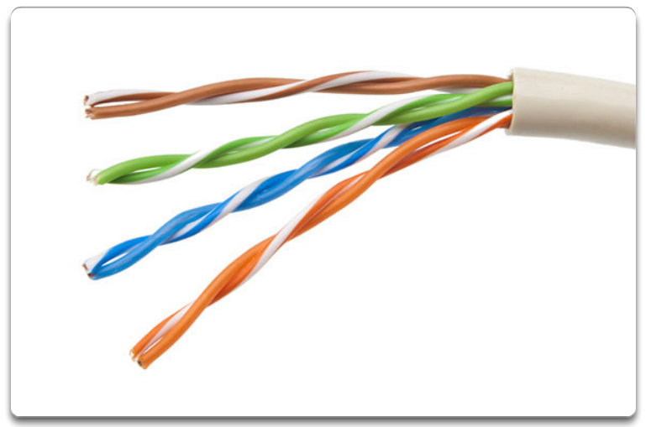
UTP Cabling
UTP cable does not use shielding to counter the effects of EMI and RFI. Instead, cable designers have discovered that they can limit the negative effect of crosstalk by:
Cancellation
Varying the number of twists per wire pair
Notes:
4.2.2.1 Properties of UTP Cabling

Slide 52
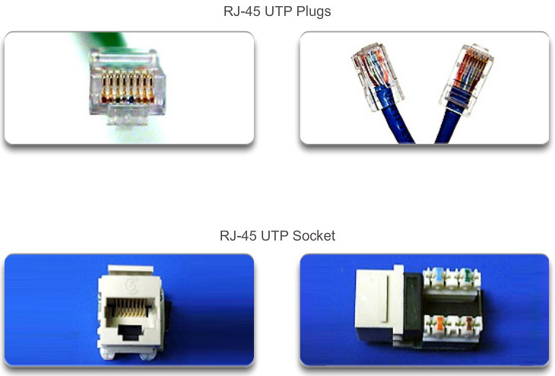
UTP Cabling UTP Connectors
Notes:
4.2.2.3 UTP Connectors

Slide 53
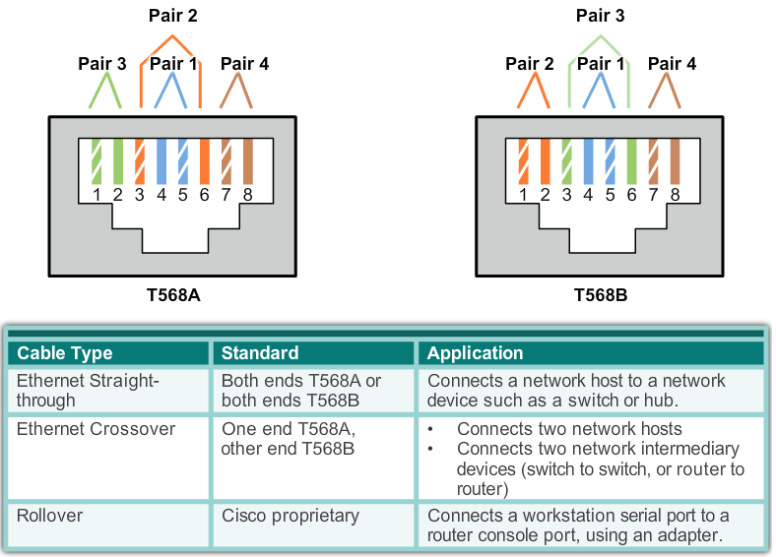
UTP Cabling Types of UTP Cable
Notes:
4.2.2.4 Types of UTP Cable

Slide 54
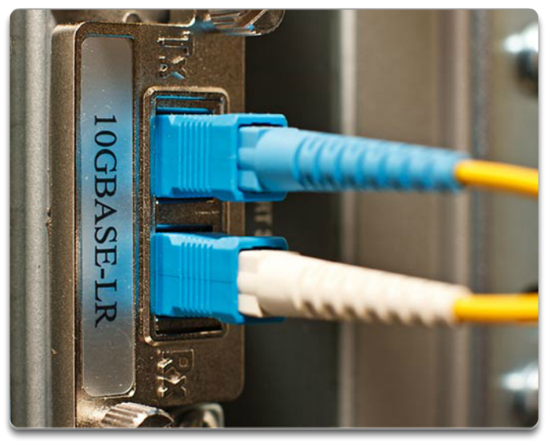
Fiber Optic Cabling Properties of Fiber Optic Cabling
Fiber-optic cabling is now being used in four types of industry:
Enterprise Networks
Fiber-to-the-home (FTTH) and Access Networks
Long-Haul Networks
Submarine Networks
Notes:
4.2.3.1 Properties of Fiber Optic Cabling

Slide 55
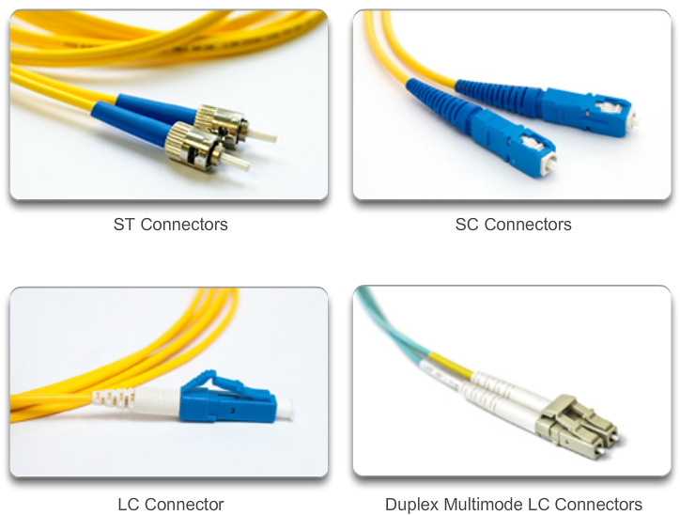
Fiber Optic Cabling Network Fiber Connectors
Notes:
4.2.3.4 Network Fiber Connectors

Slide 56



Wireless Media Types of Wireless Media
 | IEEE 802.11 standards Commonly referred to as Wi-Fi. Uses CSMA/CA Variations include: 802.11a: 54 Mbps, 5 GHz 802.11b: 11 Mbps, 2.4 GHz 802.11g: 54 Mbps, 2.4 GHz 802.11n: 600 Mbps, 2.4 and 5 GHz 802.11ac: 1 Gbps, 5 GHz 802.11ad: 7 Gbps, 2.4 GHz, 5 GHz, and 60 GHz
 | IEEE 802.15 standard Supports speeds up to 3 Mb/s Provides device pairing over distances from 1 to 100 meters.
 | IEEE 802.16 standard Provides speeds up to 1 Gbps Uses a point-to-multipoint topology to provide wireless broadband access.
Notes:
4.2.4.2 Types of Wireless Media

Slide 57
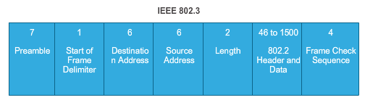
Ethernet Frame Attributes Introduction to the Ethernet Frame
Preamble and Start Frame Delimiter Fields –
Used for synchronization between the sending and receiving devices.
Length/Type Field –
Defines the exact length of the frame's data field; describes which protocol is implemented.
Data and Pad Fields –
Contains the encapsulated data from a higher layer, an IPv4 packet.
Notes:
5.1.2.3 Introduction to the Ethernet Frame

Slide 58
Ethernet Frame Attributes Introduction to the Ethernet Frame (cont.)
Frame Check Sequence Field
Used to detect errors in a frame with cyclic redundancy check (4 bytes); if calculations match at source and receiver, no error occurred.
Notes:
5.1.2.3 Introduction to the Ethernet Frame (cont.)

Slide 59
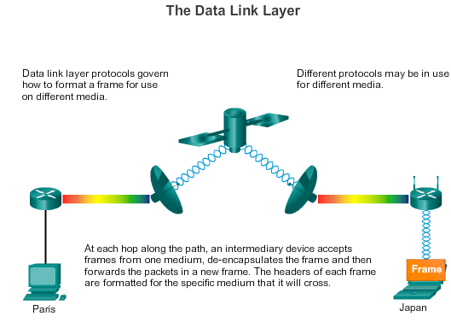
Ethernet MAC End-to-End Connectivity, MAC, and IP (cont.)
Notes:
5.1.4.2 End-to-End Connectivity, MAC, and IP (cont.)

Slide 60
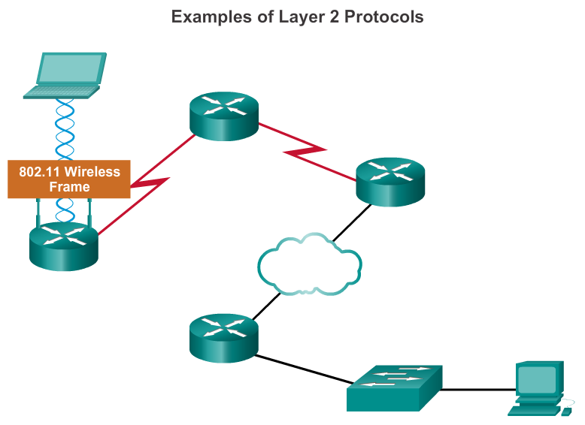
Data Link Frame LAN and WAN Frames
Notes:
4.4.4.5 LAN and WAN Frames

Slide 61
Network Layer Protocols
Notes:
Cisco Networking Academy program
Introduction to Networks
Chapter 6: Network Layer

Slide 62
Network Layer in Communication The Network Layer
The network layer, or OSI Layer 3, provides services to allow end devices to exchange data across the network. To accomplish this end-to-end transport, the network layer uses four basic processes:
Addressing end devices
Encapsulation
Routing
De-encapsulating
Notes:
6.1.1.1 The Network Layer

Slide 63
Network Layer in Communication Network Layer Protocols
Common network layer protocols include:
IP version 4 (IPv4)
IP version 6 (IPv6)
Legacy network layer protocols include:
Novell Internetwork Packet Exchange (IPX)
AppleTalk
Connectionless Network Service (CLNS/DECNet)
Notes:
6.1.1.2 Network Layer Protocols

Slide 64
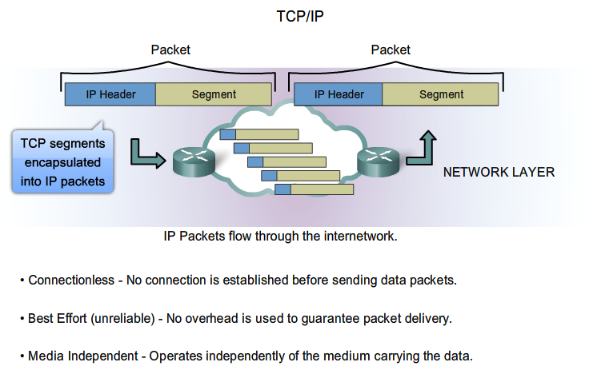
IP Characteristics IP Components
Notes:
6.1.2.1 Characteristics of IP

Slide 65
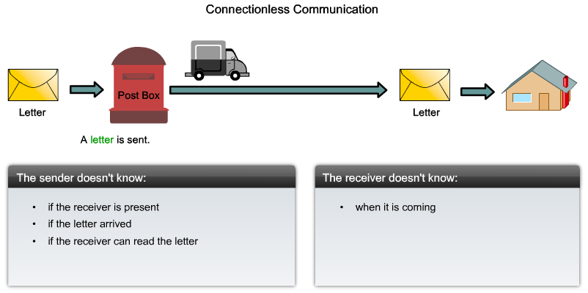
Characteristics of the IP protocol IP - Connectionless
Notes:
6.1.2.2 IP – Connectionless

Slide 66
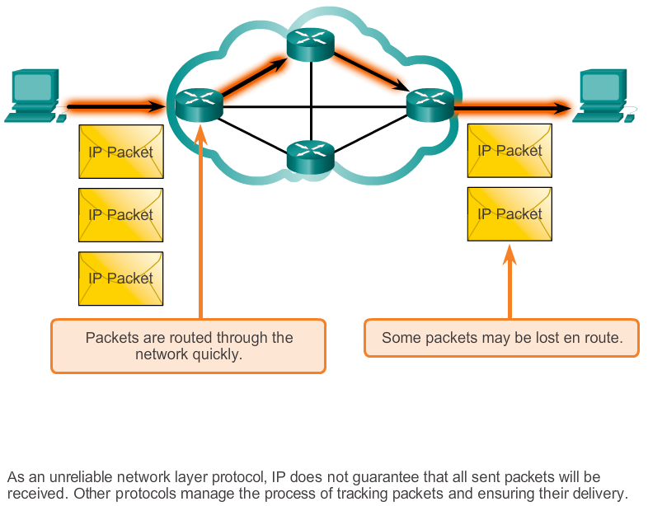
Characteristics of the IP protocol Best Effort Delivery
Notes:
6.1.2.3 IP – Best Effort Delivery

Slide 67
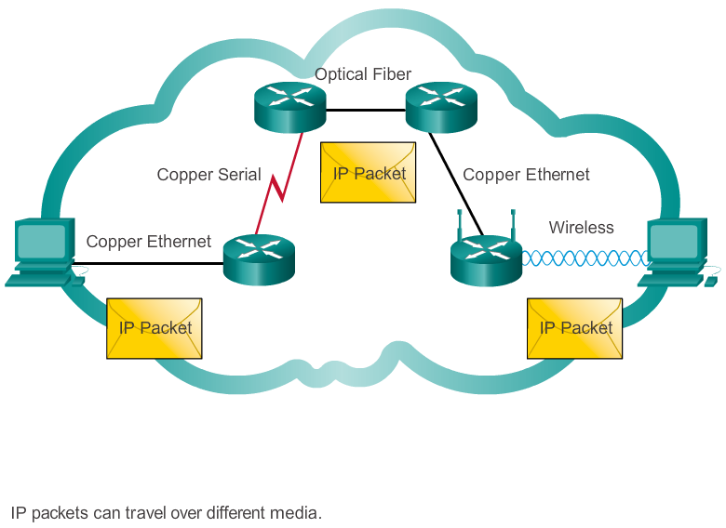
Characteristics of the IP protocol IP – Media Independent
Notes:
6.1.2.4 IP – Media Independent

Slide 68

IPv4 Packet Encapsulating IP
Notes:
6.1.2.5 Encapsulating IP

Slide 69

IPv4 Packet IPv4 Packet Header
Contents of the IPv4 packet header
Notes:
6.1.3.1 IPv4 Packet Header

Slide 70

IPv4 Packet IPv4 Header Fields
Contents of the IPv4 header fields
Notes:
6.1.3.2 IPv4 Header Fields

Slide 71

Unicast Address
Notes:
5.1.3.3 Unicast MAC Address

Slide 72

Broadcast MAC Address
Notes:
5.1.3.4 Broadcast MAC Address

Slide 73

Multicast Address
Multicast MAC address is a special value that begins with 01-00-5E in hexadecimal
Range of IPV4 multicast addresses is 224.0.0.0 to 239.255.255.255
Notes:
5.1.3.5 Multicast MAC Address

Slide 74

IPv4 Packet Sample IPv4 Headers
Notes:
6.1.3.3 Sample IPv4 Headers

Slide 75

Network Layer in Communication Limitations of IPv4
IP Address depletion
Internet routing table expansion
Lack of end-to-end connectivity
Notes:
6.1.4.1 Limitations of IPv4

Slide 76
Network Layer in Communication Introducing IPv6
Increased address space
Improved packet handling
Eliminates the need for NAT
Integrated security
4 billion IPv4 addresses 4,000,000,000
340 undecillion IPv6 addresses 340,000,000,000,000,000,000,000,000,000,000,000,000
Notes:
6.1.4.2 Introducing IPv6

Slide 77

IPv6 Packet Encapsulating IPv6
Notes:
6.1.4.3 Encapsulating IPv6

Slide 78
IPv6 Packet IPv6 Packet Header
Byte 1
Byte 2
Byte 3
Byte 4
Version | Traffic Class |  | Flow Label
Payload Length |  |  |  | Next Header | Hop Limit
Source IP Address
Destination IP Address
Notes:
6.1.4.4 IPv6 Packet Header

Slide 79

IPv6 Packet Sample IPv6 Header
Notes:
6.1.4.5 Sample IPv6 Header

Slide 80
Routing
Notes:
Cisco Networking Academy program
Introduction to Networks
Chapter 6: Network Layer

Slide 81

Host Routing Tables Host Packet Forwarding Decision
Notes:
6.2.1.1 Host Forwarding Decision

Slide 82
Host Routing Tables Default Gateway
Hosts must maintain their own, local, routing table to ensure that network layer packets are directed to the correct destination network. The local table of the host typically contains:
Direct connection
Local network route
Local default route
R
Notes:
6.2.1.2 Default Gateway

Slide 83

Router Routing Tables Router Packet Forwarding Decision
Notes:
6.2.2.1 Router Packet Forwarding Decision

Slide 84
Router Routing Tables IPv4 Router Routing Table
192.168.10.0/24
10.1.1.0/24
PC1
.10
G0/0
.1
209.165.200.224 /30
.10
.1
R1
.225
S0/0/0
.226
R2
.10
.1
G0/1
.1
.10
PC2
192.168.11.0/24
10.1.2.0/24
R1#show ip route
Codes: L - local, C - connected, S - static, R - RIP, M - mobile, B - BGP
D - EIGRP, EX - EIGRP external, O - OSPF, IA - OSPF inter area
N1 - OSPF NSSA external type 1, N2 - OSPF NSSA external type 2
E1 - OSPF external type 1, E2 - OSPF external type 2, E - EGP
i - IS-IS, L1 - IS-IS level-1, L2 - IS-IS level-2, ia - IS-IS inter area
* - candidate default, U - per-user static route, o - ODR
P - periodic downloaded static route
Gateway of last resort is not set
10.0.0.0/8 is variably subnetted, 2 subnets, 2 masks
D 10.1.1.0/24 [90/2170112] via 209.165.200.226, 00:00:05, Serial0/0/0
D 10.1.2.0/24 [90/2170112] via 209.165.200.226, 00:00:05, Serial0/0/0
192.168.10.0/24 is variably subnetted, 2 subnets, 3 masks
C 192.168.10.0/24 is directly connected, GigabitEthernet0/0
L 192.168.10.1/32 is directly connected, GigabitEthernet0/0
192.168.11.0/24 is variably subnetted, 2 subnets, 3 masks
C 192.168.11.0/24 is directly connected, GigabitEthernet0/1
L 192.168.11.1/32 is directly connected, GigabitEthernet0/1
209.165.200.0/24 is variably subnetted, 2 subnets, 3 masks
C 209.165.200.224/30 is directly connected, Serial0/0/0
L 209.165.200.225/32 is directly connected, Serial0/0/0
R1#
Notes:
6.2.2.2 IPv4 Router Routing Table

Slide 85
Router Routing Tables Directly Connected Routing Table Entries
192.168.10.0/24
64.100.0.1
10.1.1.0/24
PC1
.10
G0/0
.1
209.165.200.224 /30
.10
.1
R1
.225
S0/0/0
.226
R2
.10
.1
G0/1
.1
.10
PC2
192.168.11.0/24
10.1.2.0/24
A
B
C
C 192.168.10.0/24 is directly connected, GigabitEthernet0/0
L 192.168.10.1/32 is directly connected, GigabitEthernet0/0
A | Identifies how the network was learned by the router.
B | Identifies the destination network and how it is connected.
C | Identifies the interface on the router connected to the destination network.
Notes:
6.2.2.3 Directly Connected Routing Table Entries

Slide 86
Router Routing Tables Remote Network Routing Table Entries
192.168.10.0/24
64.100.0.1
10.1.1.0/24
PC1
.10
G0/0
.1
209.165.200.224 /30
.10
.1
R1
.225
S0/0/0
.226
R2
.10
.1
G0/1
.1
.10
PC2
192.168.11.0/24
10.1.2.0/24
D 10.1.1.0/24 [90/2170112] via 209.165.200.226, 00:00:05, Serial0/0/0
A | Identifies how the network was learned by the router.
B | Identifies the destination network.
C | Identifies the administrative distance (trustworthiness) of the route source.
D | Identifies the metric to reach the remote network.
E | Identifies the next hop IP address to reach the remote network.
F | Identifies the amount of elapsed time since the network was discovered.
G | Identifies the outgoing interface on the router to reach the destination network.
Notes:
6.2.2.4 Remote Network Routing Table Entries

Slide 87
Router Routing Tables Next-Hop Address
192.168.10.0/24
64.100.0.1
10.1.1.0/24
PC1
.10
G0/0
.1
209.165.200.224 /30
.10
.1
R1
.225
S0/0/0
.226
R2
.10
.1
G0/1
.1
.10
PC2
192.168.11.0/24
10.1.2.0/24
R1#show ip route
Codes: L - local, C - connected, S - static, R - RIP, M - mobile, B - BGP
D - EIGRP, EX - EIGRP external, O - OSPF, IA - OSPF inter area
N1 - OSPF NSSA external type 1, N2 - OSPF NSSA external type 2
E1 - OSPF external type 1, E2 - OSPF external type 2, E - EGP
i - IS-IS, L1 - IS-IS level-1, L2 - IS-IS level-2, ia - IS-IS inter area
* - candidate default, U - per-user static route, o - ODR
P - periodic downloaded static route
Gateway of last resort is not set
10.0.0.0/8 is variably subnetted, 2 subnets, 2 masks
D 10.1.1.0/24 [90/2170112] via 209.165.200.226, 00:00:05, Serial0/0/0
D 10.1.2.0/24 [90/2170112] via 209.165.200.226, 00:00:05, Serial0/0/0
192.168.10.0/24 is variably subnetted, 2 subnets, 3 masks
C 192.168.10.0/24 is directly connected, GigabitEthernet0/0
L 192.168.10.1/32 is directly connected, GigabitEthernet0/0
192.168.11.0/24 is variably subnetted, 2 subnets, 3 masks
C 192.168.11.0/24 is directly connected, GigabitEthernet0/1
L 192.168.11.1/32 is directly connected, GigabitEthernet0/1
209.165.200.0/24 is variably subnetted, 2 subnets, 3 masks
C 209.165.200.224/30 is directly connected, Serial0/0/0
L 209.165.200.225/32 is directly connected, Serial0/0/0
R1#
Notes:
6.2.2.5 Next-Hop Address

Slide 88
Routers
Notes:
Cisco Networking Academy program
Introduction to Networks
Chapter 6: Network Layer

Slide 89

Anatomy of a Router A Router is a Computer
Notes:
6.3.1.1 A Router is a Computer

Slide 90

Anatomy of a Router Router CPU and OS
Notes:
6.3.1.2 Router CPU and OS

Slide 91
Anatomy of a Router Router Memory
Memory | Volatile / Non-Volatile | Stores
RAM | Volatile | Running IOS Running configuration file IP routing and ARP tables Packet buffer
ROM | Non-Volatile | Bootup instructions Basic diagnostic software Limited IOS
NVRAM | Non-Volatile | Startup configuration file
Flash | Non-Volatile | IOS Other system files
Notes:
6.3.1.3 Router Memory

Slide 92

Anatomy of a Router Inside a Router
Power Supply
Shield for WIC
Fan
SDRAM
NVRAM
CPU
Advanced Integration Module (AIM)
1
2
2
5
4
6
7
3
Notes:
6.3.1.4 Inside a Router

Slide 93

Anatomy of a Router Router Backplane
Double-Wide EHWIC slots
EHWIC 0
AUX
Port
LAN
Interfaces
Console RJ45
USB
Ports
Two 4 GB Flash Card Slots
Console
USB Type B
Notes:
6.3.1.5 Router Backplane

Slide 94

Router Boot-up Bootset Files
Notes:
6.3.2.2 Bootset Files

Slide 95
Router Boot-up Show Versions Output
Router# show version
Cisco IOS Software, C1900 Software (C1900-UNIVERSALK9-M), Version 15.2(4)M1, RELEASE SOFTWARE (fc1)
Technical Support: http://www.cisco.com/techsupport
Copyright (c) 1986-2012 by Cisco Systems, Inc.
Compiled Thu 26-Jul-12 19:34 by prod_rel_team
ROM: System Bootstrap, Version 15.0(1r)M15, RELEASE SOFTWARE (fc1)
Router uptime is 10 hours, 9 minutes
System returned to ROM by power-on
System image file is "flash0:c1900-universalk9-mz.SPA.152-4.M1.bin"
Last reload type: Normal Reload
Last reload reason: power-on
<Output omitted>
Cisco CISCO1941/K9 (revision 1.0) with 446464K/77824K bytes of memory.
Processor board ID FTX1636848Z
2 Gigabit Ethernet interfaces
2 Serial(sync/async) interfaces
1 terminal line
DRAM configuration is 64 bits wide with parity disabled.
255K bytes of non-volatile configuration memory.
250880K bytes of ATA System CompactFlash 0 (Read/Write)
<Output omitted>
Technology Package License Information for Module:'c1900'
-----------------------------------------------------------------
Technology Technology-package Technology-package
Current Type Next reboot
------------------------------------------------------------------
ipbase ipbasek9 Permanent ipbasek9
security None None None
data None None None
Configuration register is 0x2142 (will be 0x2102 at next reload)
Router#
Notes:
6.3.2.4 Show Version Output

Slide 96
Configuring a Router
Notes:
Cisco Networking Academy program
Introduction to Networks
Chapter 6: Network Layer

Slide 97
Configure Initial Settings Router Configuration Steps
192.168.10.0/24
10.1.1.0/24
PC1
.10
G0/0
.1
209.165.200.224 /30
.10
.1
R1
.225
S0/0/0
.226
R2
.10
.1
G0/1
.1
.10
PC2
192.168.11.0/24
10.1.2.0/24
Router> enable
Router# configure terminal
Enter configuration commands, one per line. End with CNTL/Z.
Router(config)# hostname R1
R1(config)#
Router> en
Router# conf t
Enter configuration commands, one per line. End with CNTL/Z.
Router(config)# ho R1
R2(config)#
OR
R1(config)# enable secret class
R1(config)#
R1(config)# line console 0
R1(config-line)# password cisco
R1(config-line)# login
R1(config-line)# exit
R1(config)#
R1(config)# line vty 0 4
R1(config-line)# password cisco
R1(config-line)# login
R1(config-line)# exit
R1(config)#
R1(config)# service password-encryption
R1(config)#
R1(config)# banner motd #
Enter TEXT message. End with the character '#'.
***********************************************
WARNING: Unauthorized access is prohibited!
***********************************************
#
R1(config)#
R1# copy running-config startup-config
Destination filename [startup-config]?
Building configuration...
[OK]
R1#
Notes:
6.4.1.1 Router Configuration Steps

Slide 98
Configure Interfaces Configure LAN Interfaces
192.168.10.0/24
10.1.1.0/24
PC1
.10
G0/0
.1
209.165.200.224 /30
.10
.1
R1
.225
S0/0/0
.226
R2
.10
.1
G0/1
.1
.10
PC2
192.168.11.0/24
10.1.2.0/24
R1# conf t
Enter configuration commands, one per line. End with CNTL/Z.
R1(config)#
R1(config)# interface gigabitethernet 0/0
R1(config-if)# ip address 192.168.10.1 255.255.255.0
R1(config-if)# description Link to LAN-10
R1(config-if)# no shutdown
%LINK-5-CHANGED: Interface GigabitEthernet0/0, changed state to up
%LINEPROTO-5-UPDOWN: Line protocol on Interface GigabitEthernet0/0, changed state to up
R1(config-if)# exit
R1(config)#
R1(config)# int g0/1
R1(config-if)# ip add 192.168.11.1 255.255.255.0
R1(config-if)# des Link to LAN-11
R1(config-if)# no shut
%LINK-5-CHANGED: Interface GigabitEthernet0/1, changed state to up
%LINEPROTO-5-UPDOWN: Line protocol on Interface GigabitEthernet0/1, changed state to up
R1(config-if)# exit
R1(config)#
Notes:
6.4.2.1 Configure LAN Interfaces

Slide 99
Configure Interfaces Verify Interface Configuration
192.168.10.0/24
10.1.1.0/24
PC1
.10
G0/0
.1
209.165.200.224 /30
.10
.1
R1
.225
S0/0/0
.226
R2
.10
.1
G0/1
.1
.10
PC2
192.168.11.0/24
10.1.2.0/24
R1# show ip interface brief
Interface IP-Address OK? Method Status Protocol
GigabitEthernet0/0 192.168.10.1 YES manual up up
GigabitEthernet0/1 192.168.11.1 YES manual up up
Serial0/0/0 209.165.200.225 YES manual up up
Serial0/0/1 unassigned YES NVRAM administratively down down
Vlan1 unassigned YES NVRAM administratively down down
R1#
R1# ping 209.165.200.226
Type escape sequence to abort.
Sending 5, 100-byte ICMP Echos to 209.165.200.226, timeout is 2 seconds:
!!!!!
Success rate is 100 percent (5/5), round-trip min/avg/max = 1/2/9 ms
R1#
Notes:
6.4.2.2 Verify Interface Configuration

Slide 100
Configuring the Default Gateway Default Gateway on a Host
Default Gateway not needed
PC1
.10
192.168.10.0/24
.1
G0/0
Default Gateway needed
PC2
.10
R1
G0/1
.1
PC1
.10
192.168.10.0/24
.1
G0/0
.10
PC2
.11
PC3
R1
.10
192.168.11.0/24
G0/1
.1
PC4
PC3
.10
.11
192.168.11.0/24
PC4
Notes:
6.4.3.1 Default Gateway on a Host

